Slide 1
Throw Away the Key: Blockchain-ed Healthcare Data
Kathy Zhai
GlaxoSmithKline
PhilaSUG 2019

Slide 2
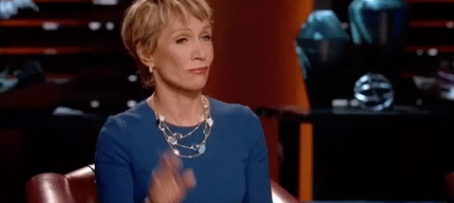
POLL

Slide 3
My Interest in Blockchain
Lack of trust with incomplete, missing, inaccurate data
Better solution
Investments
Emerging technology

Slide 4
History of Blockchain
Early 1990’s Bayer, Haber, Stornetta - Notaries
2008 financial crisis
Satoshi Nakamoto – Bitcoins

Slide 5
Centralized Network and Decentralized Network
Centralized
Hierarchy, one set of rules
Decentralized
Hierarchy but delegates decision making to individual teams
Example: Food Franchise make own rules while following major rules
Stored on a network on computers
  Public network
  Wikipedia (Fully protect, semi-protect, free for all)
  Private network – Specific to study
  Information only for particular drug

Slide 6
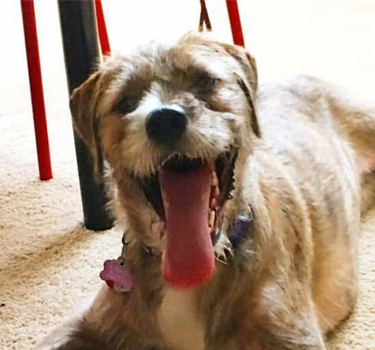
What is it??
a85ha862hs9
Unique Hash
96agad86adg
Previous Hash
000
Birth date
Vital Signs
Timestamp

Slide 7
How are blocks created?
A
B
C
10 minutes to create
Calculate the proof-of-work to build a new block
Distributed to all users in the network
If block is accepted and validated by more than 51% of the network, every user adds the block to their ledger (chain)

Slide 8
How is the blockchain tamper proof?
C
D
E
Unique Hash
ad97gad8g9
Unique Hash
pkd7gap8g2
Unique Hash
aaeah9838nj
Unique Hash
ei2n8al8a8eh
Previous Hash
esd90ega8e
Previous Hash
ad97gad8g9
Previous Hash
aaeah9838nj
Proof of work will need to be recreated for all subsequent blocks

Slide 9
Use in Healthcare
Startups analyzing patient health history and evolving patterns to audit prescription and medication usage
Longitudinal medical history
Increase trust amongst pharmacists, doctors, patients
Preventing data issues

Slide 10
Pros
Audit trail
Transparency
Trust in the blockchain
Immutable
Cons
Requires training
Must be regulated with the FDA, GCP, HIPAA
Hire third party

Slide 11
Conclusion

Slide 12

Kathy Zhai
GlaxoSmithKline
Kathy.x.zhai@gsk.com

